Slide 1

Terrorism in europe
An in-depth analysis of the history and evolution of terror in the westernmost part of Eurasia.

Slide 2
The idea
Recent increase in terror-attacks.

Slide 3
The idea
Recent increase in terror-attacks.
Media tend to be inaccurate and untrustworthy, just like poorly-made histograms.

Slide 4

The idea
Recent increase in terror-attacks.
Media tend to be inaccurate and untrustworthy, just like poorly-made histograms.
Data-driven insight can help shed light on the truth

Slide 5
The dataset
Metric | World | Europe-only
Samples | 170.000 | 21.155
Features | 18 | 18
Size | 30MB | 6MB
Found in Kaggle.

Slide 6
The dataset
Metric | World | Europe-only
Samples | 170.000 | 21.155
Features | 18 | 18
Size | 30MB | 6MB
Found in Kaggle.
Contains world-wide data on terrorism.

Slide 7
The dataset
Metric | World | Europe-only
Samples | 170.000 | 21.155
Features | 18 | 18
Size | 30MB | 6MB
Found in Kaggle.
Contains world-wide data on terrorism.
Covers 46 years, 1970s to 2016.

Slide 8
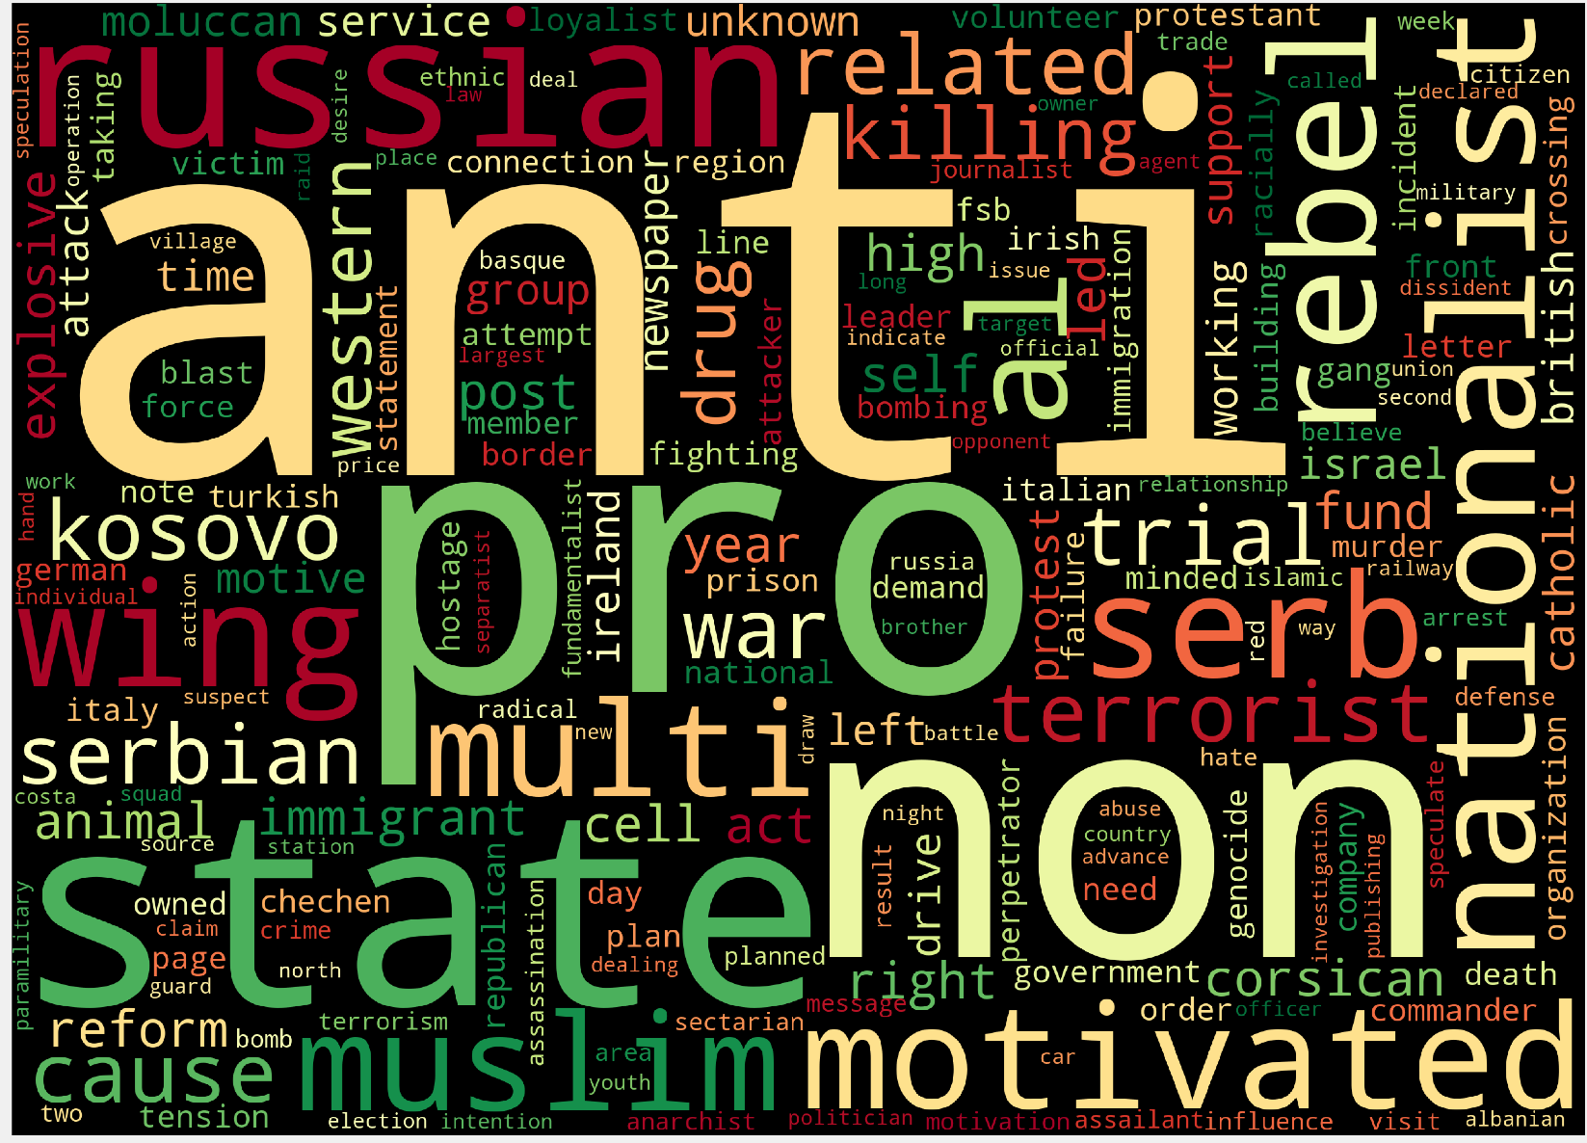
Exploratory analysis
Word-cloud

Slide 9

Exploratory analysis
Word-cloud
A word-cloud, generated from the descriptions of attacks carried-out in Europe.

Slide 10
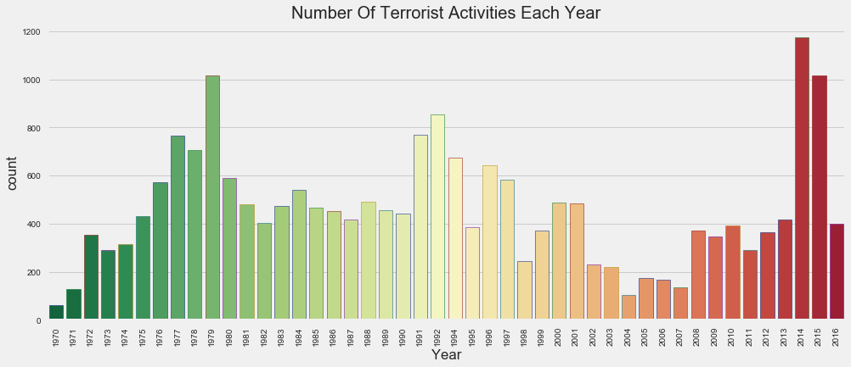
Exploratory analysis
Activity over the years
A word-cloud, generated from the descriptions of each attack in Europe.

Slide 11
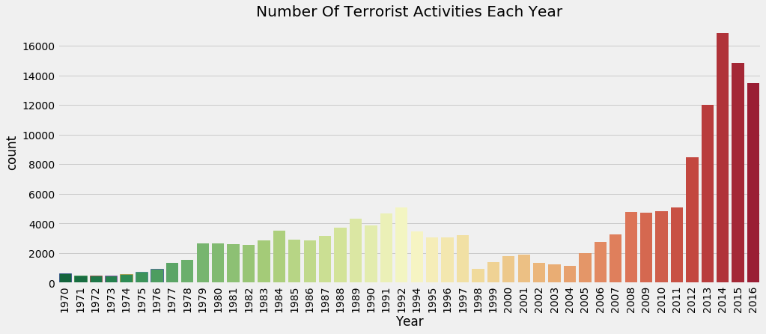
Exploratory analysis
Activity over the years
Europe
World-wide

Slide 12
Exploratory analysis
Activity over the years
Europe
World-wide
While terrorism is on the rise globally, we can clearly see that in Europe this situation is nothing new.

Slide 13
Exploratory analysis
Activity over the years
Europe
World-wide
While terrorism is on the rise globally, we can clearly see that in Europe this situation is nothing new.
In fact, 1978 and 1992 marked two similar peaks in terror-activity.

Slide 14
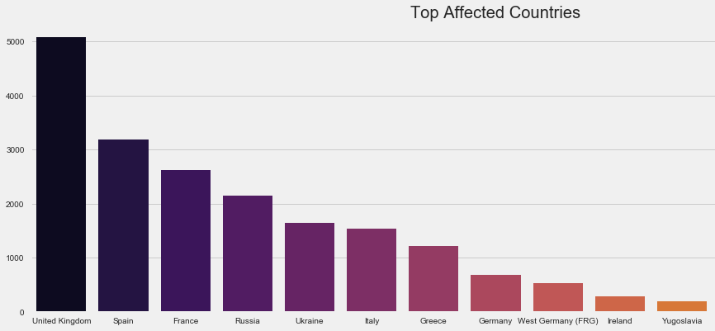
Exploratory analysis
Most affected countries

Slide 15
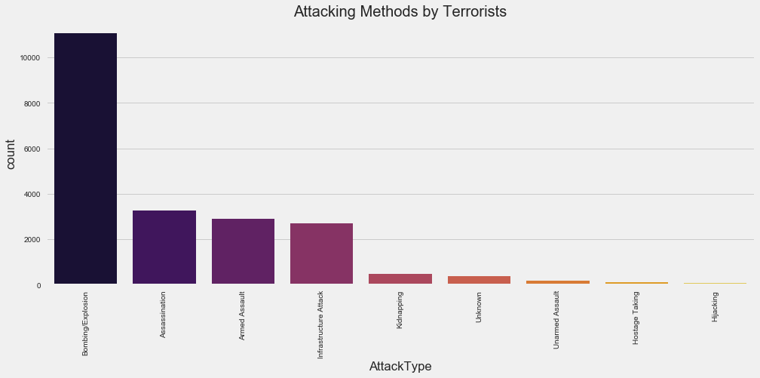
Exploratory analysis
Most popular attack types

Slide 16
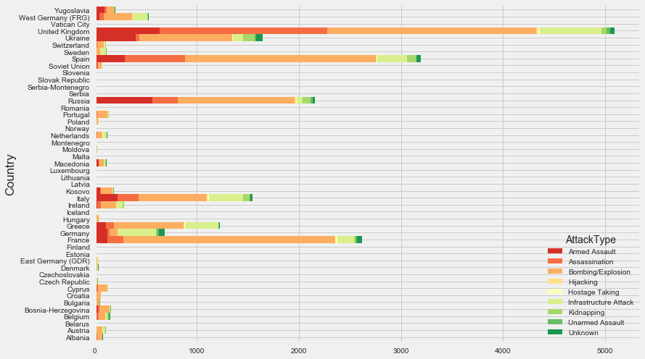
Exploratory analysis
Attack type breakdown per country

Slide 17
Exploratory analysis
Attack type breakdown per country
We can see that the methods of attack are quite proportionate throughout Europe, with Armed Assault and Assassination clearly being the go-to methods.

Slide 18
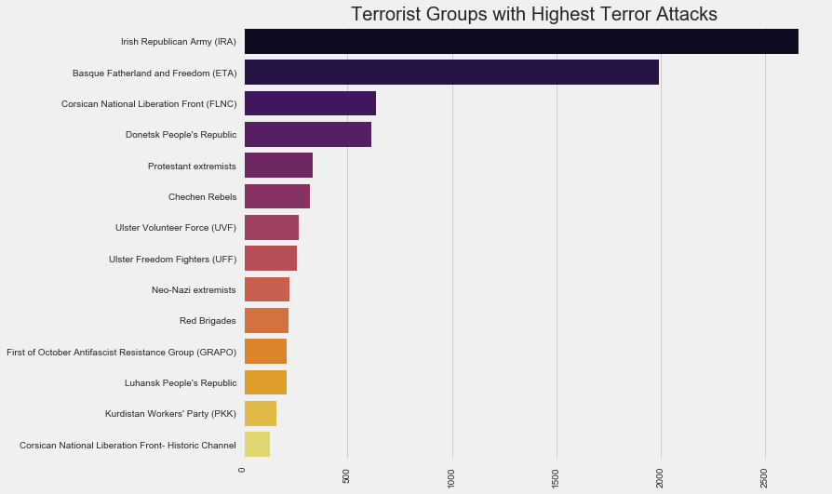
Exploratory analysis
Deadliest organizations

Slide 19
Exploratory analysis
Deadliest organizations
While quite a few attacks by ISIS happened in 2017 (and are not included), the organizations first attack happened in 2006.
With all the media attention one would think that they’d have, at least, appeared in the top-10.

Slide 20

Exploratory analysis
Deadliest organizations
While quite a few attacks by ISIS happened in 2017 (and are not included), the organizations first attack happened in 2006.
With all the media attention one would think that they’d have, at least, appeared in the top-10.

Slide 21
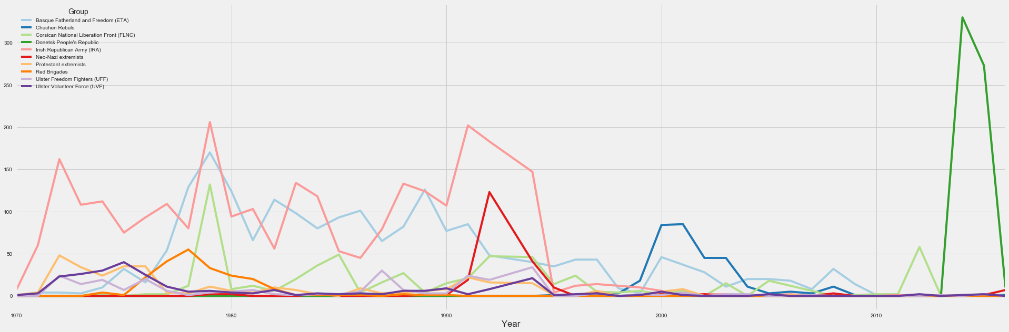
Exploratory analysis
Activity of each organization from the ‘70s

Slide 22
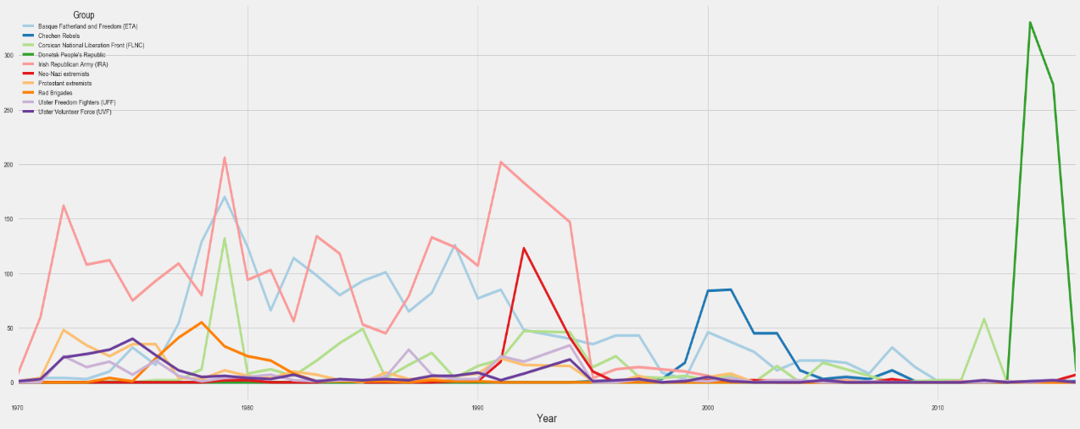
Exploratory analysis
Activity of each organization from the ‘70s
That green spike in recent years, could that be ISIS?
Nope. It is Donetsk People's Republic, a Russia-backed organization in Ukraine.
Yes, we know. We hadn’t heard of them either.

Slide 23
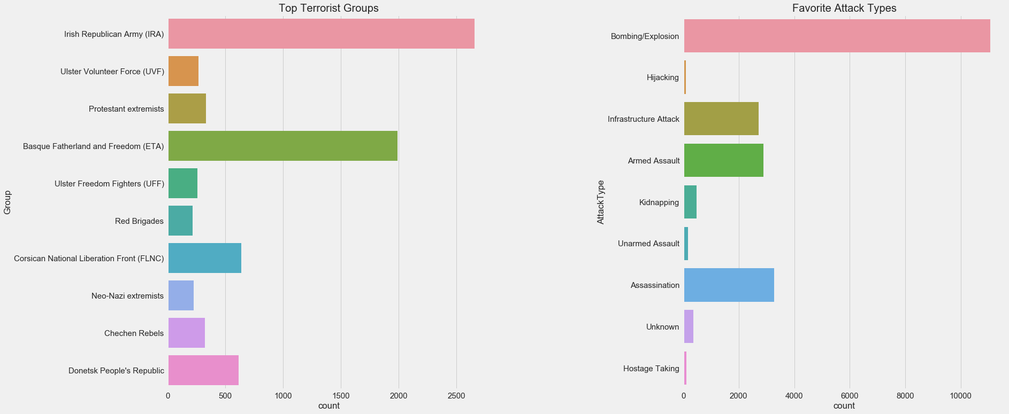
Exploratory analysis
Association of each attack type with the group using it the most.

Slide 24
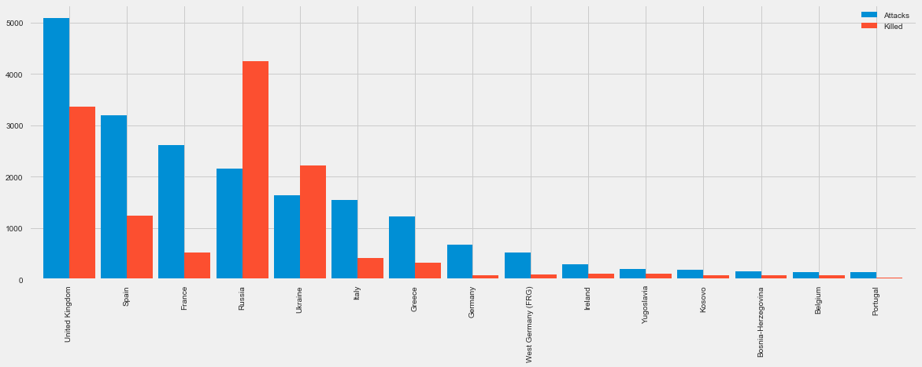
Exploratory analysis
Total amount of victims to victims killed, per country

Slide 25
Exploratory analysis
Total amount of victims to victims killed, per country
The two obvious outliers here are Russia and Ukraine, the only two countries on the continent to have more killed than wounded in terror-attacks.
France is also mention-worthy as the country with the least percentage of deaths in terror-related attacks.

